Slide 1
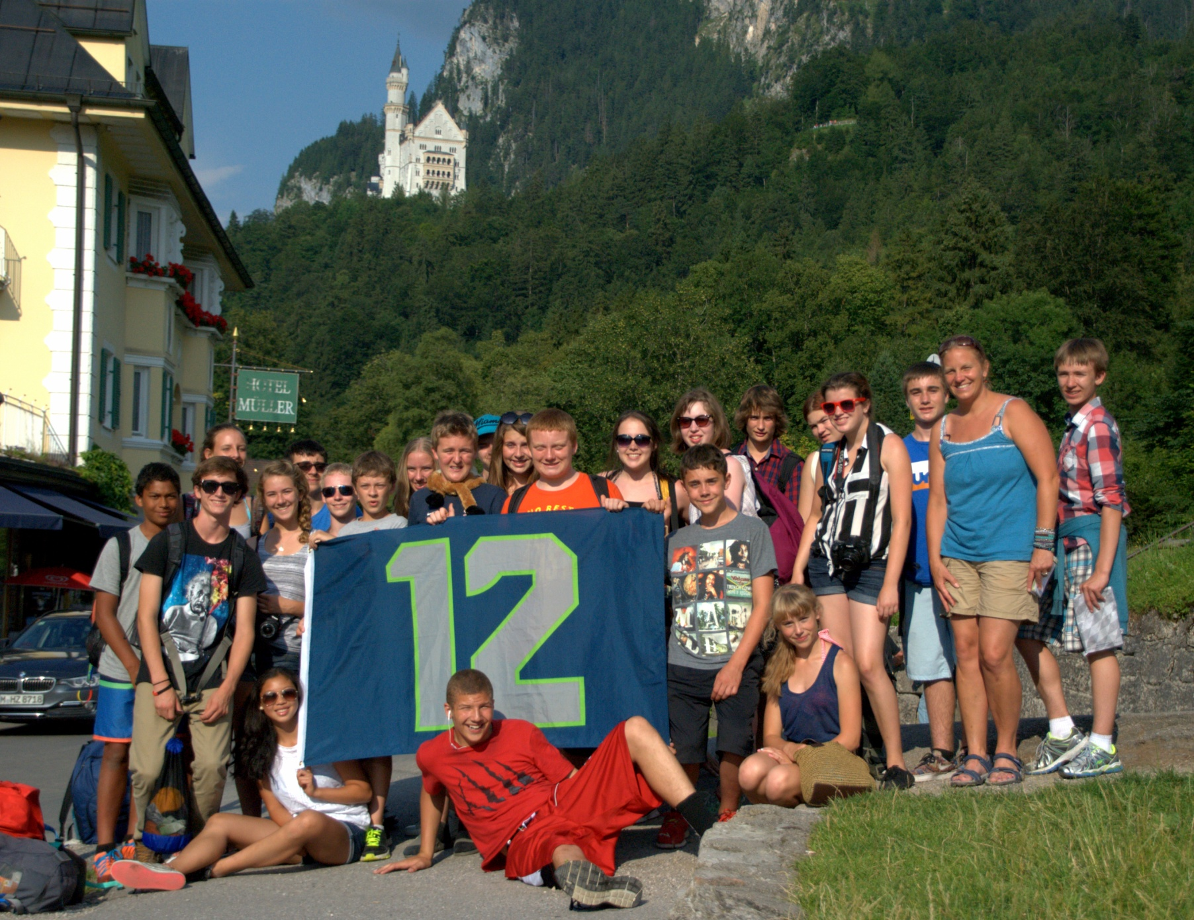
B-E to Germany Exchange

Slide 2
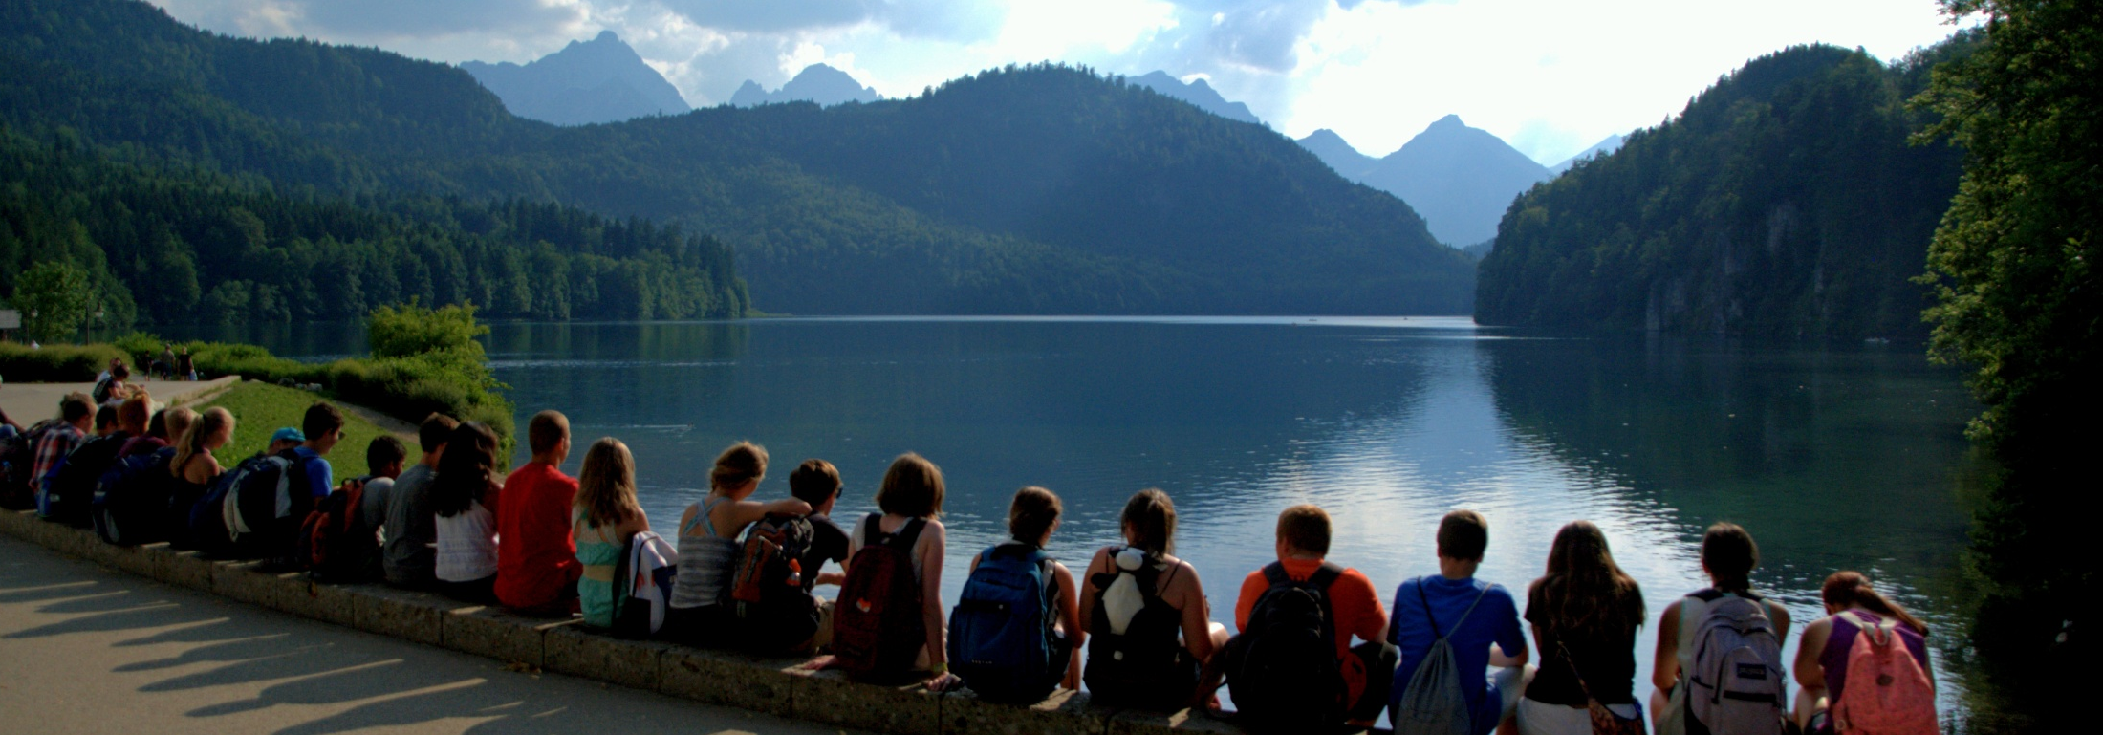
Who?
Open to all 6th through 8th grade students
Priority is given to those 6th and 7th graders from the B-E District who have not been before
Group size is limited to 24
Ms. Wesen, Ms. Keahey, Mrs. Rankin and Mr. Davidson will facilitate

Slide 3
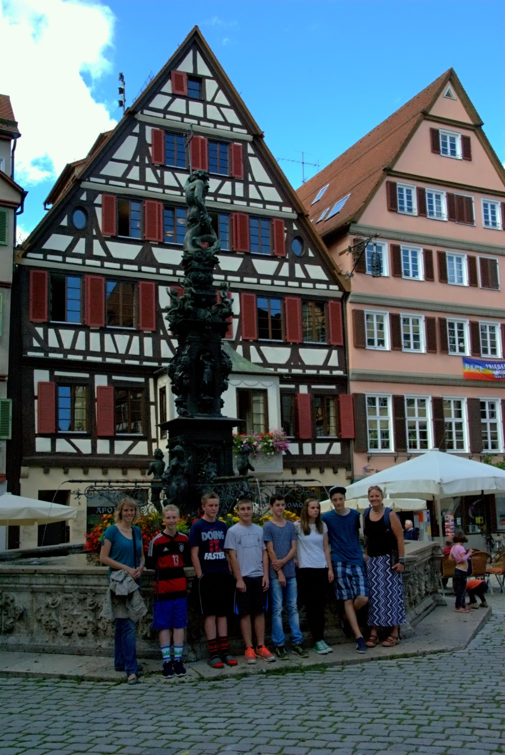
When?
A $100 deposit to hold a space on the
next exchange is due by May 1st
Student information forms will
be collected before the end of
school
Students will be paired by early summer
Based on common interests
Based on family situations
Students will communicate via
email and internet right away

Slide 4
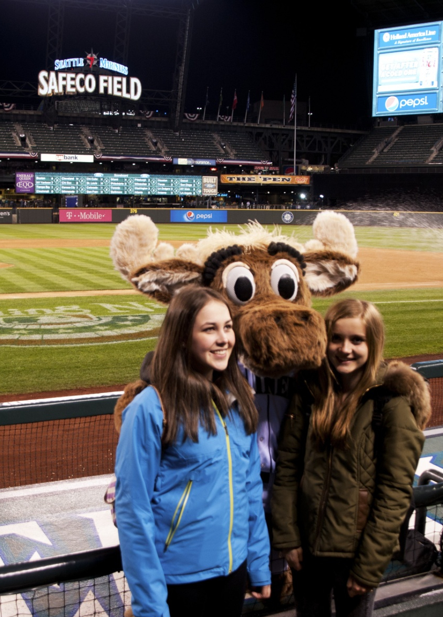
When?
Meetings will take place starting in January to prep for the hosting leg
Basic German will be taught
Common misconceptions and
problems will be briefed
Ideas for what to do when they
are here will be discussed

Slide 5
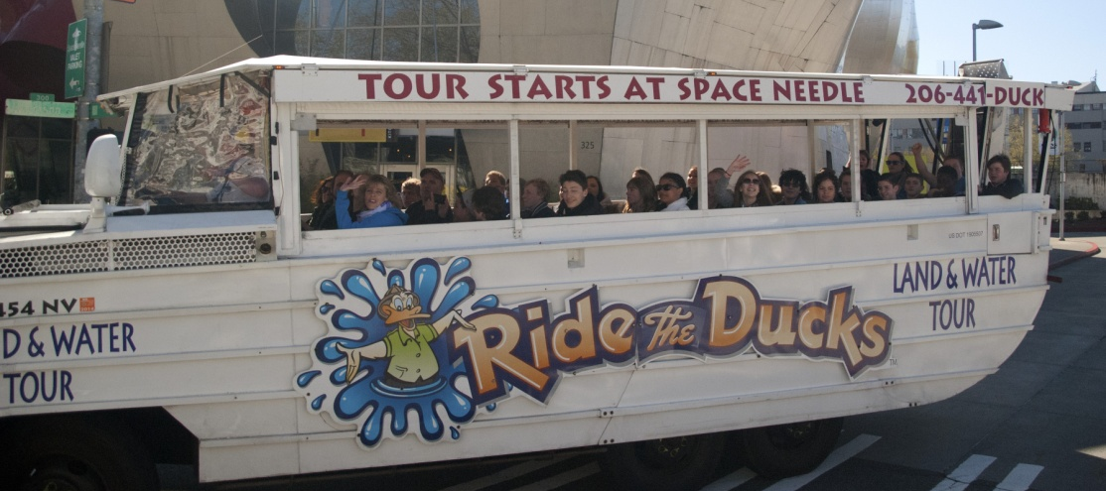
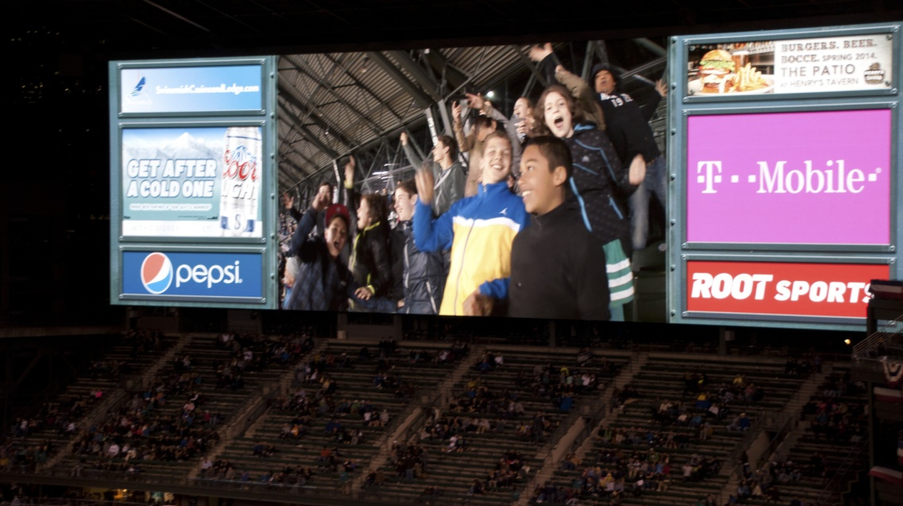
When?
The German students and
teachers will arrive prior to Spring Break
They will attend school in the district
We will participate in full group activities
You will have time to plan other family activities with your student
German students will have enrichment activities
They will return to Germany around the end of Spring Break
A total of about 3 weeks

Slide 6
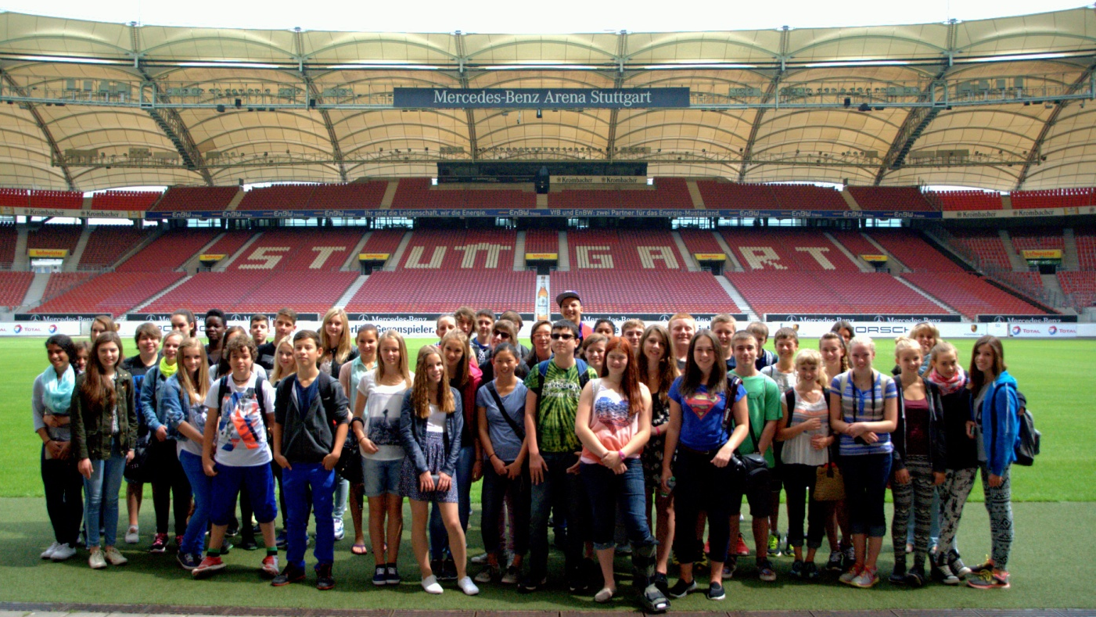
When?
After they have left, classes will shift to travel prep
In late June we will depart for Germany!
We will remain there for three weeks

Slide 7
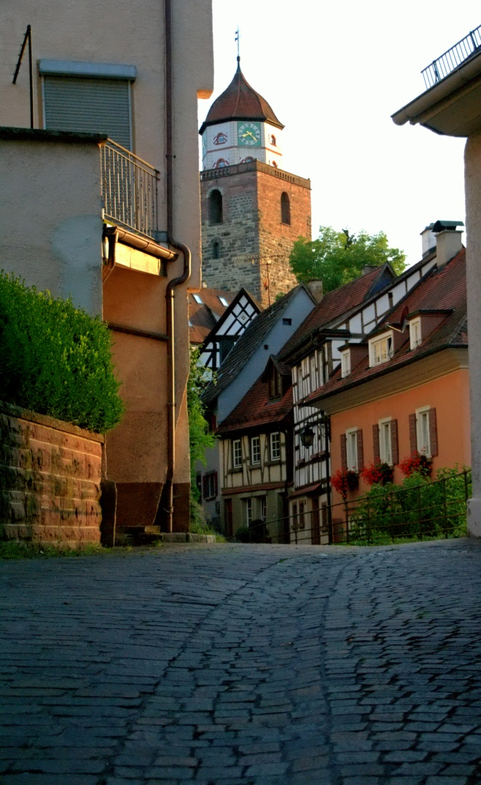
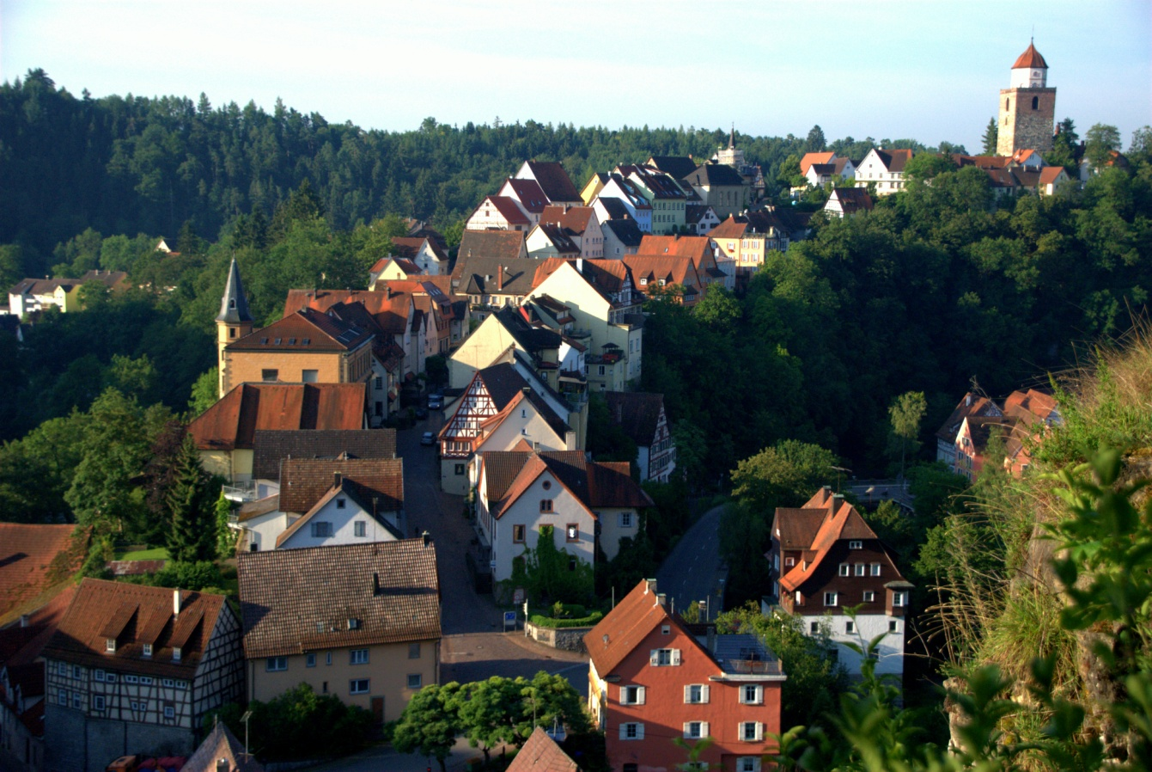
Where?
Haigerloch
Approximately 60km South of Stuttgart
A town of approximately 10,000
Partnering With Realschule Haigerloch

Slide 8
Why?
To experience!
A different culture
To step out of your comfort zone
To create memories and friends that will last a lifetime

Slide 9
Cost
The cost of hosting another “child”
Travel costs have ranged between $1,200 and $1,800 (airfare!)
Side trips to be determined
Costs in Germany are dependant upon the limits you set
Spending money
The German Government provides funds for our students!

Slide 10
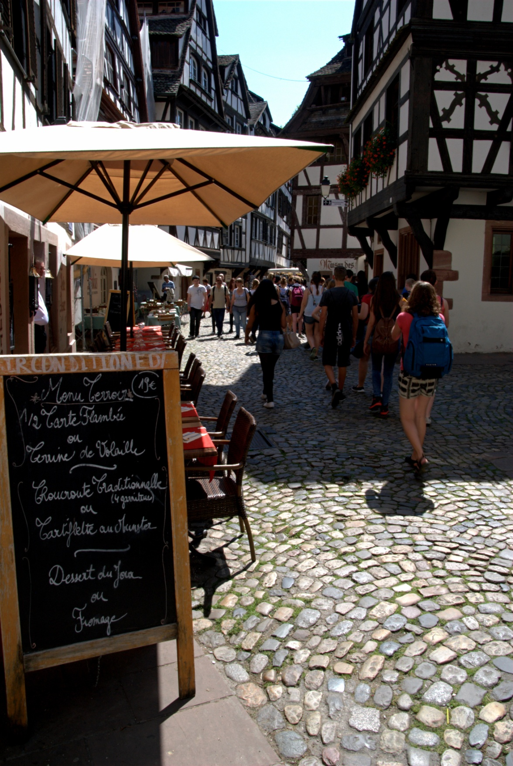
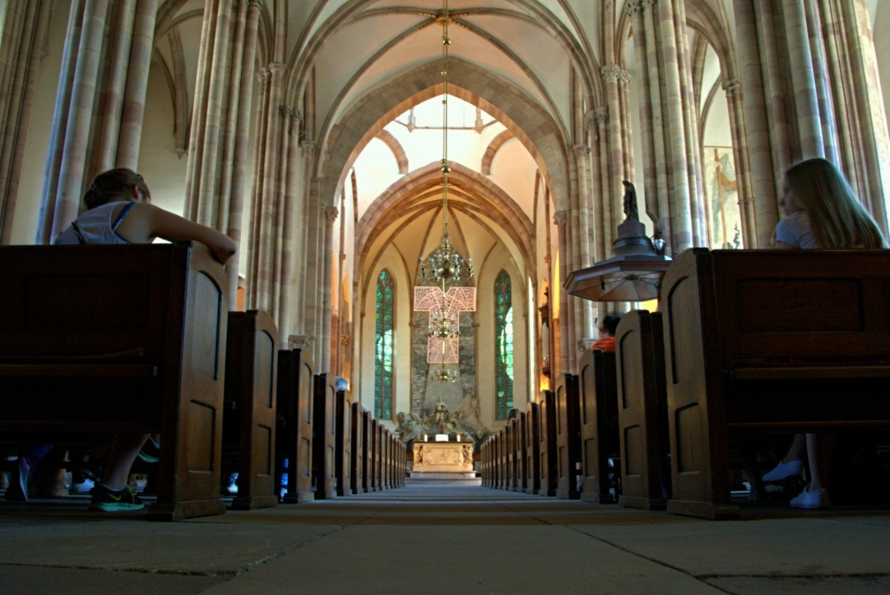
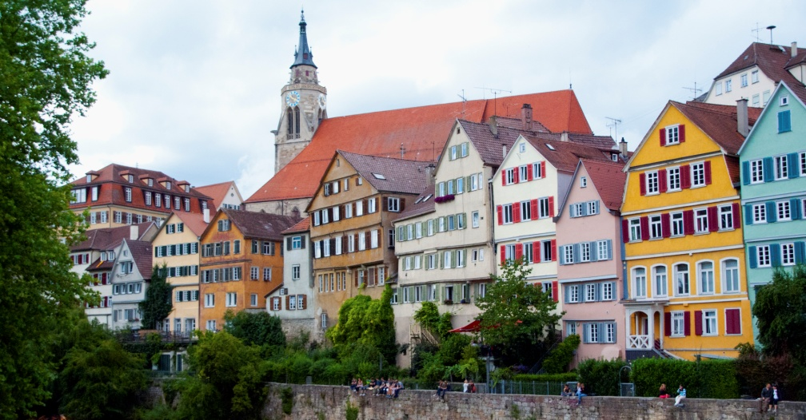
Questions?

Slide 11
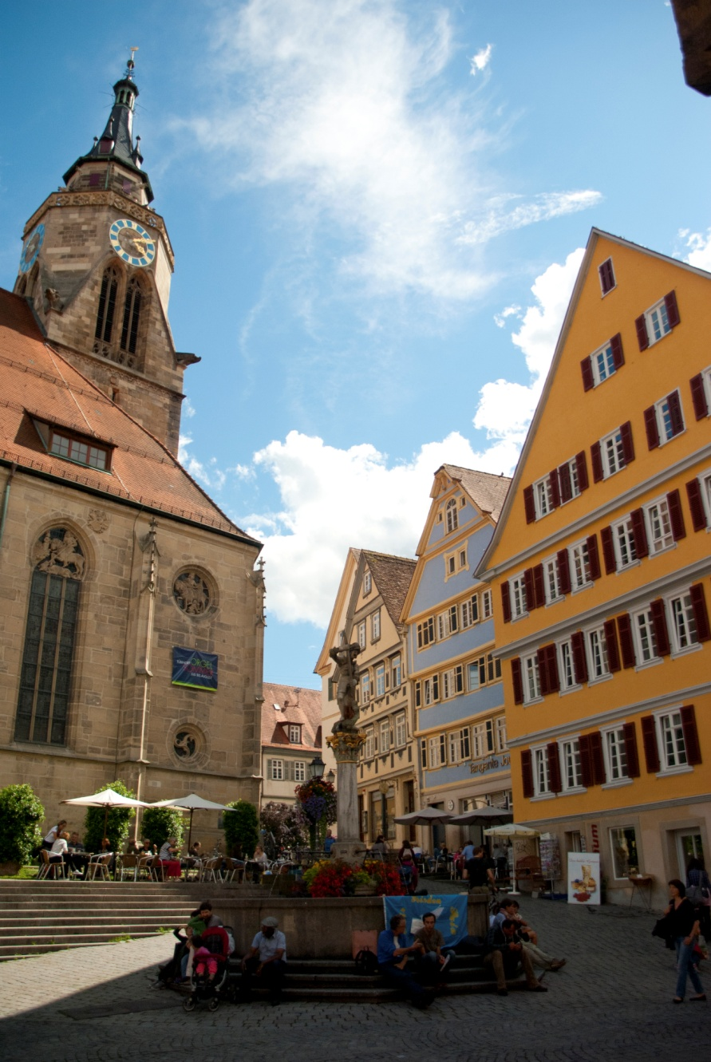
Blog
The blogs that were written for the past three Exchanges are available online for your enjoyment!
Web Site

Slide 12
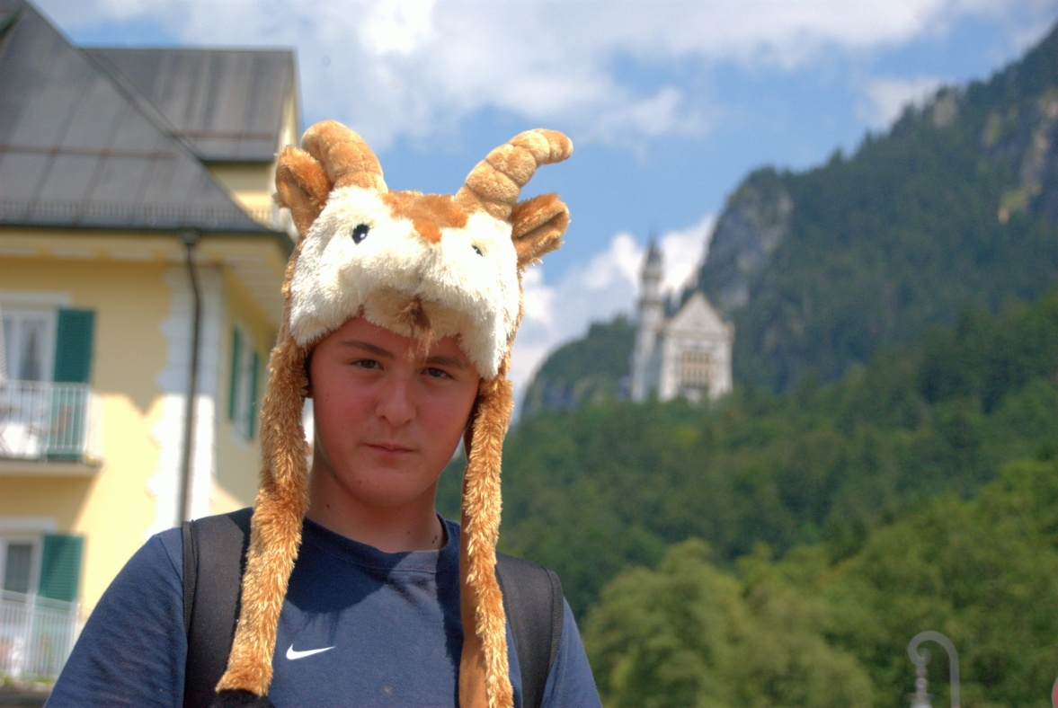
Thanks For Coming!

